Slide 1
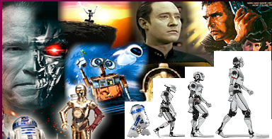
371323864
372427616
377845128
Final AIDA Project
Image Captioning
April 26 to 30, 2021 Andras Baligacs, Rainer-Anton Englisch, Thomas Schremser
Functional Colors
Red (Functional)
Yellow (Functional)
Green (Functional)

Slide 2
Agenda
Mission, Approach and Results
Technical Details

Slide 3
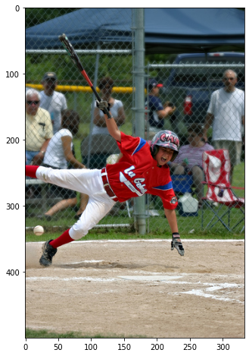
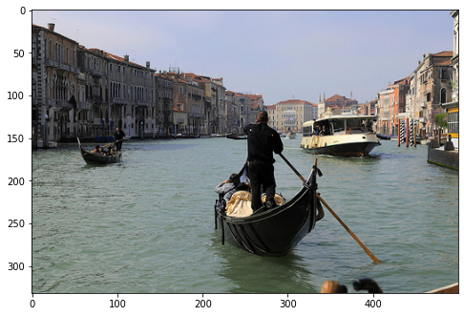
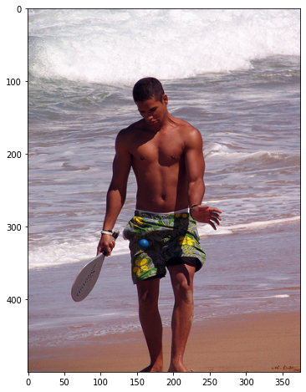
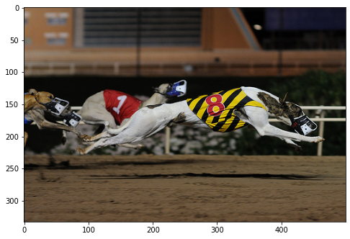
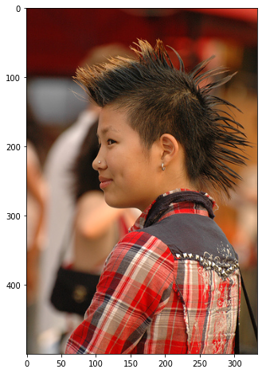
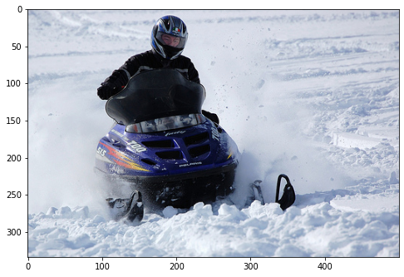
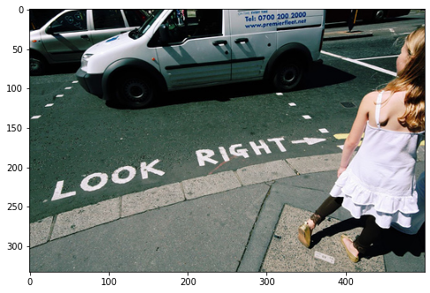
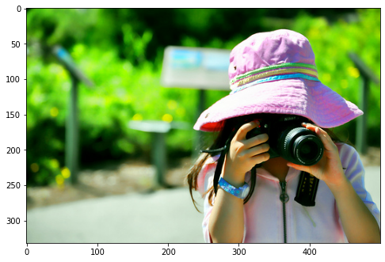
Mission
A man in swim trunks hits a ball with a paddle , while on the beach
A baseball player runs on the field
A gondola is steered through the canals with other boats around
A dog wearing the number 8 leads in a dog race
Build up a Model for captioning pictures!
A girl with a nose ring , earring and Mohawk
A man riding a purple snowmobile
A little girl in a pink hat holds a camera to her face
A girl is on the sidewalk looking at a white van in the street

Slide 4
Solution Context
Encoder-Decoder Architecture
flickr 8k data collection
ROUGE-L Recall and BLEU-1 Precision metrics
https://kobiso.github.io/Computer-Vision-Leaderboard/imagenet.html
Notes:
Convolutional neural network which

Slide 5
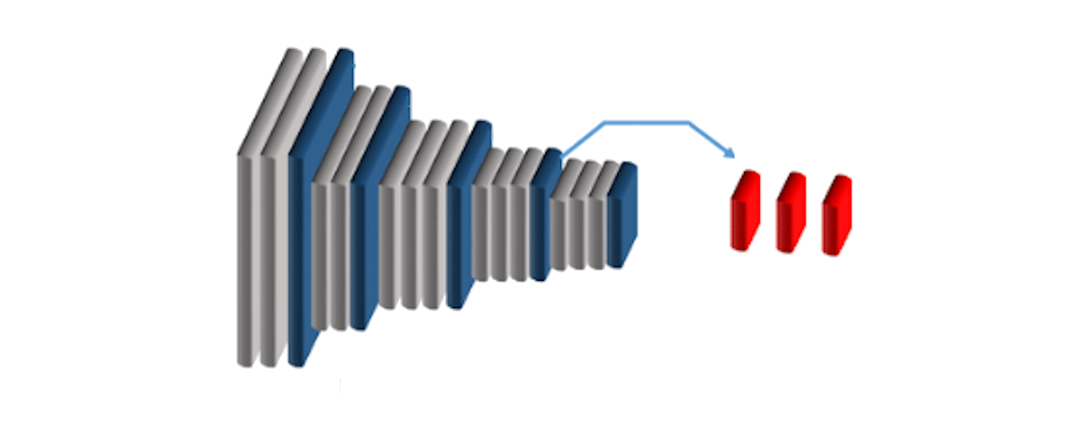
Encoder-Decoder Architecture
A baseball player runs on the field
Encoder - Part (CNN) Decoder - Part (RNN)

Slide 6

flickr 8k data collection
8,091 JPG-ecoded color pictures
Each picture has labeled by five captions (sentences)

Slide 7
Example Picture
Reference captions:
A baseball hitter holding a bat falling down .
Baseball player runs on the field .
A boy at bat playing a baseball game falls to the ground while onlookers watch .
A child in a uniform is falling to the ground with a bat in his or her hand .
This baseball player, dressed in red and white uniform and holding a bat, is falling after being hit by a pitch .

Slide 8

Metrics
ROUGE-L Recall*
Measures the longest matching sequence of words between reference and candidate sentence
perfect match = 1 | 0 = no match
------------------------------------------------------------------------------------------------------------------------------------------------------------------------------------------------------------------------------------------------------------------------------------------------------------------------------------------------------------------------------------------------------------------------------------------------------------------------------------------------------------------------
BLEU-1 Precision**
Measures the matching of words (unigrams, 1-grams) between reference and candidate sentence
perfect match = 1 | 0 = no match
* Recall: related to the number of words in reference sentence ** Precision: related to the number words in of candidate sentence
Notes:
F1.- Result

Slide 9
Our Approach
Planning architecture high level and do researches
Build up Baseline model
Create custom function for ROUGE-L and BLEU-1 calculation
Preprocessing text sentences (lower case, special characters)
Model generation iterations:
Preprocessing Pictures and CNN features for RNN input (resizing)
Running trainings and predictions
Build up further models or change hyper-parameters of existing models
https://kobiso.github.io/Computer-Vision-Leaderboard/imagenet.html
Notes:
Convolutional neural network which

Slide 10
Results
Model | Train |  | Test
 | BLEU-1 | ROUGE-L | BLEU-1 | ROUGE-L
Baseline | 0.5901 | 0.5149 | 0.4008 | 0.3579
InceptV3 GRU NoAttention CustEmbedding | 0.5794 | 0.5093 | 0.4036 | 0.3646
InceptV3 LSTM Attention CustEmbedding | 0.4401 | 0.4520 | 0.4464 | 0.4537
InceptV3 GRU NoAttention CustEmbedding 768-units-all | 0.6102 | 0.5415 | 0.4028 | 0.3639
Baseline Glove Word vectors | 0.6715 | 0.5893 | 0.3968 | 0,3592
Baseline Glove Word vectors 2x LSTM | 0.2631 | 0.4028 | 0.2503 | 0.3515
Inception-ResNet-V2 GRU NoAttention CustEmbedding | 0.4934 | 0.4023 | 0.4401 | 0.3624
Notes:
Aussage zu Balancierung des Data Sets
ohne threshold *

Slide 11
Results
Model | Train |  | Test
 | BLEU-1 | ROUGE-L | BLEU-1 | ROUGE-L
Baseline | 0.5901 | 0.5149 | 0.4008 | 0.3579
InceptV3 GRU NoAttention CustEmbedding | 0.5794 | 0.5093 | 0.4036 | 0.3646
InceptV3 LSTM Attention CustEmbedding | 0.4401 | 0.4520 | 0.4464 | 0.4537
InceptV3 GRU NoAttention CustEmbedding 768-units-all | 0.6102 | 0.5415 | 0.4028 | 0.3639
Baseline Glove Word vectors | 0.6715 | 0.5893 | 0.3968 | 0,3592
Baseline Glove Word vectors 2x LSTM | 0.2631 | 0.4028 | 0.2503 | 0.3515
Inception-ResNet-V2 GRU NoAttention CustEmbedding | 0.4934 | 0.4023 | 0.4401 | 0.3624
Notes:
Aussage zu Balancierung des Data Sets
ohne threshold *

Slide 12
Winner Model
Model: InceptV3 LSTM Attention CustEmbedding
Encoder: InceptionV3 (256 units) Decoder: LSTM (512 units, 256 embedding size) ROUGE-L Recall (Test): 45.37 % BLEU-1 Precision (Test): 44.64 %
Loss (Test): 9.805 Loss (Train): 0.732
Training time: 30 minutes
Notes:
https://www.researchgate.net/figure/Schematic-diagram-of-a-basic-convolutional-neural-network-CNN-architecture-26_fig1_336805909

Slide 13
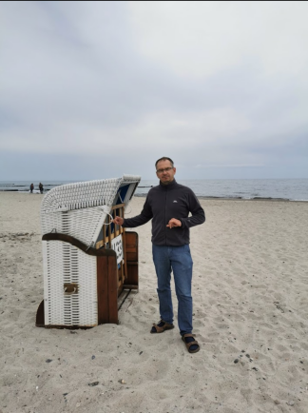
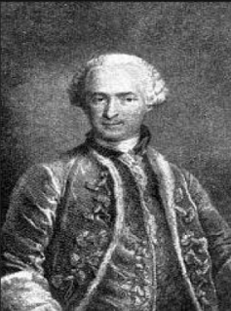
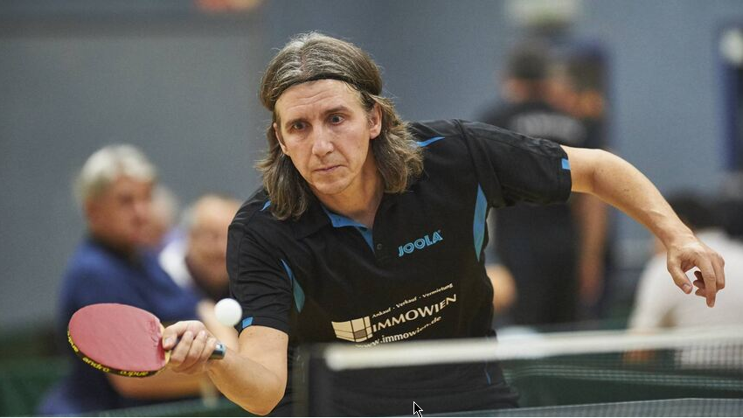
Reality Check
Predicted Caption
a man in a blue shirt is riding a bike down a dirt road
a boy in a red shirt is playing with a red toy
a man in a black jacket and a woman in a red shirt is looking at a man in a red shirt

Slide 14
Technical Details

Slide 15
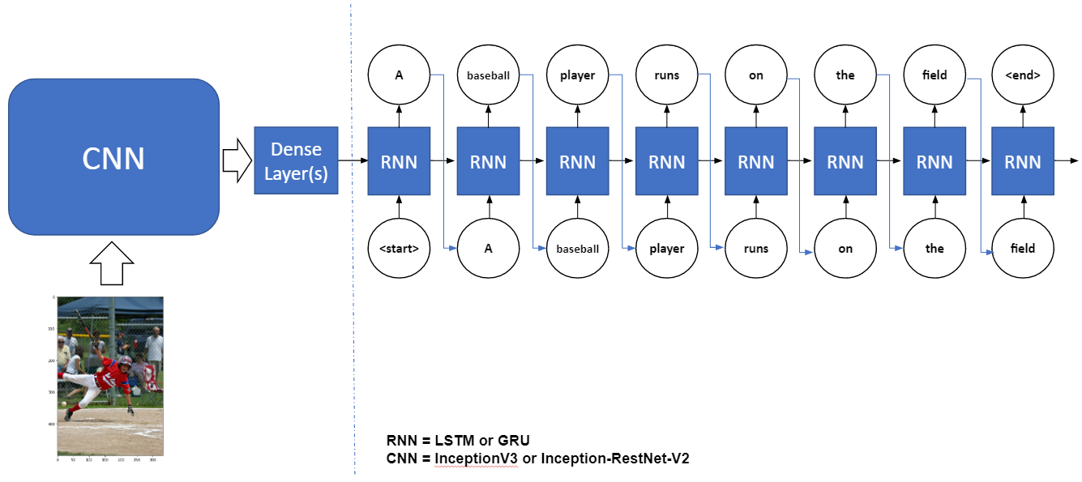
Encoder-Decoder Architecture
Decoder

Slide 16
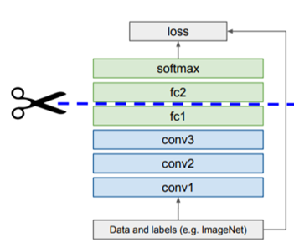
Preprocessing Pictures
Image Features
1007129816_e794419615.npy
Notes:
F1.- Result

Slide 17
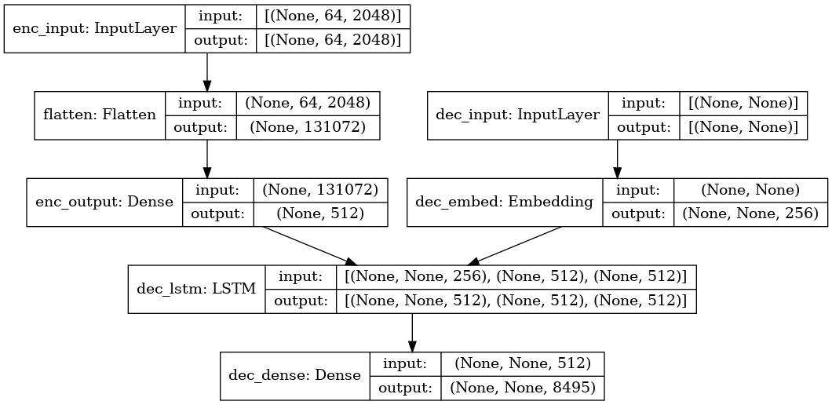
Preprocessing CNN features for RNN input
Image Features
1007129816_e794419615.npy
Notes:
F1.- Result

Slide 18
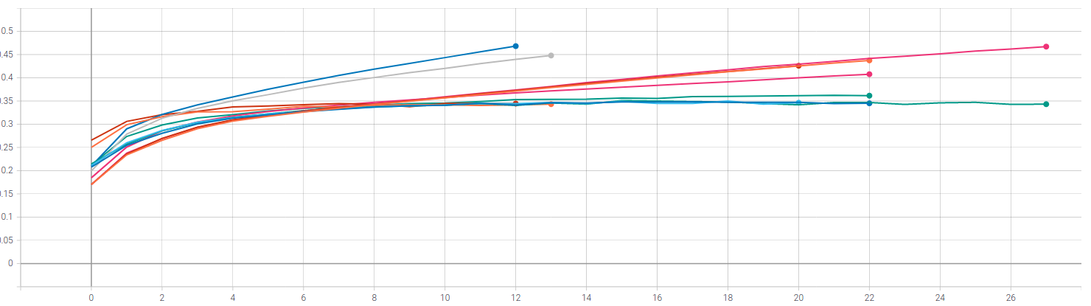
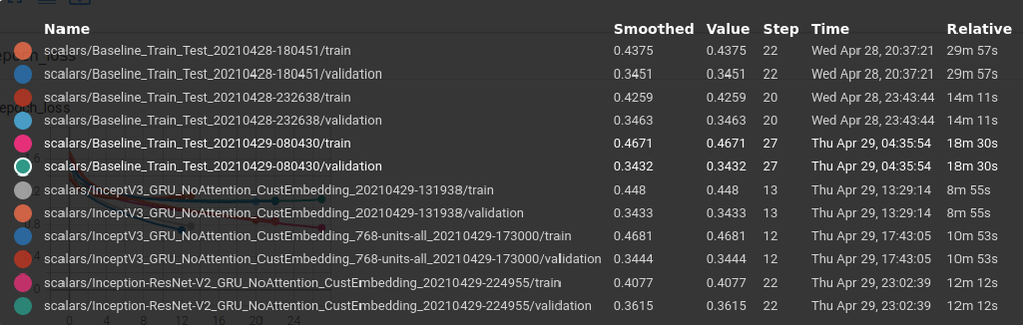
Accuracy per Epoch
Notes:
F1.- Result

Slide 19
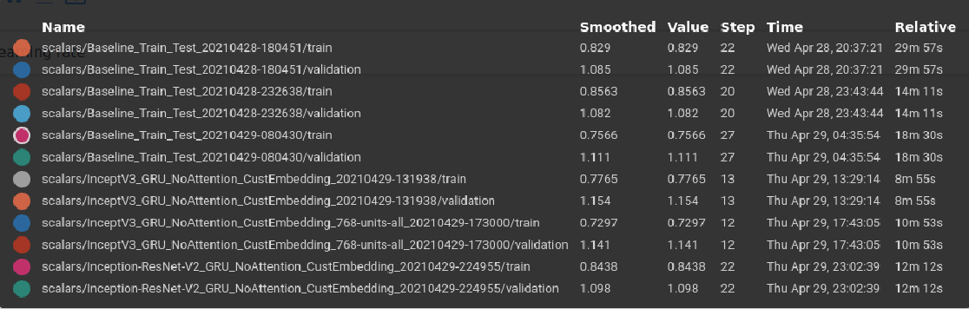
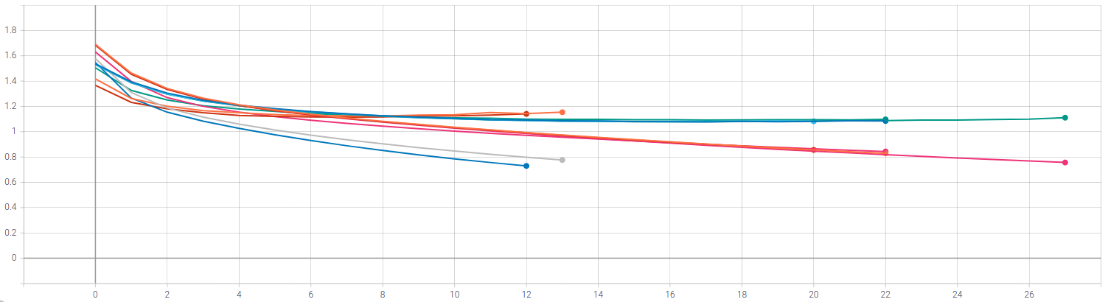
Loss per Epoch
Notes:
F1.- Result

Slide 20
ROUGE-L Recall
Measures the longest matching sequence of words between reference and candidate sentence
(perfect match = 1, no match = 0)
Example: Reference sentence: police killed the gunman yesterday
Candidate sentences:
police kill the gunman -> ROUGE-L Recall = 3/5 = 0.6 -> longest sequence: police the gunman
the gunman kill police -> ROUGE-L Recall = 2/5 = 0.4 -> longest sequence: the gunman
Notes:
F1.- Result

Slide 21
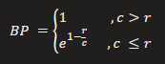
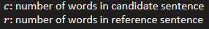
BLEU-1 Precision
Measures the matching of words (unigrams, 1-grams) between reference and candidate sentence
(perfect match = 1, no match = 0, clipped = word count reduced to max. occurrences in reference sentence)
Brevity Penalty:
Example: Reference sentence: police killed the gunman yesterday
Candidate sentences:
police kill the gunman -> BLEU-1 Precision = 0.778 * 3/4 = 0.58 -> overlaping words: police, the, gunman
the gunman kill police -> BLEU-1 Precision = 0.778 * 3/4 = 0.58 -> overlaping words: police, the, gunman
Notes:
F1.- Result

Slide 22
BACKUP

Slide 23
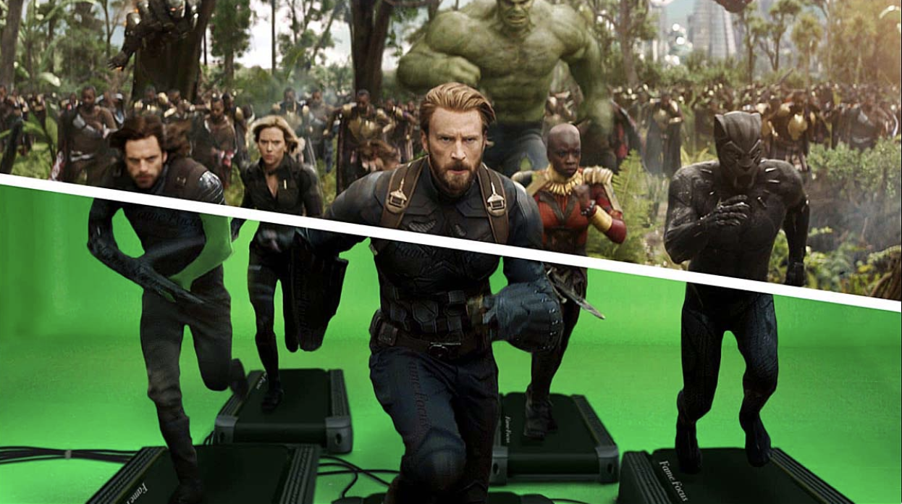
Where we run? / Kaggle
Kaggle Dataset for Images
Version in Background
Private Data 100 GB
GPU 41 hrs per week
TPU 30 hrs per week

Slide 24
Development
Python ML and Deep Learning Tools
Development Environments
Kaggle Notebooks and Dataframe
Local Jupyter Lab
Local Visual Studio Code

Slide 25
Management of Artefacts
Git-Hub
Source code
Small data files (up to 25 MB)
Google-Drive
M5 Model files
Presentation

Slide 26
Modeling
Keras API
Keras ImageDataGenerator and custom implementation Resized images e.g. 299x299x3

